Slide 1
CTE Certification Step-by-step

Slide 2
There are multiple Pathways to certification
Based on industry experience
Based on education
Based on teaching experience

Slide 3
FOUR STEPS WE WILL TAKE IN THIS PRESENTATION
Step 1
Select the CTE program you want to teach and certificate needed for that program
Step 2
Identify which certification pathway is easiest to meet
Step 3
Identify the requirements and your timeline
Step 4
Identify the supports that are in place to help you earn that certificate

Slide 4
Let’s start with step #1
Step 1
Select the CTE program you want to teach and certificate needed for that program
Step 2
Identify which certification pathway is easiest to meet
Step 3
Identify the requirements and your timeline
Step 4
Identify the supports that are in place to help you earn that certificate

Slide 5
The 6 areas of CTE certification
CTE - Agriculture
CTE - Business and Marketing
CTE - Education and Training
CTE - Family and Consumer Sciences
CTE - Health Careers
CTE - Industrial and Emerging Technologies

Slide 6
Let’s look at the programs requiring Agriculture certification
Agriscience
Veterinary Assisting
Bioscience (or IET or HC)

Slide 7
Let’s look at the programs requiring Business and Marketing certification
Accounting
Business Management
Business Operations
Finance
Marketing
Project SEARCH
Fashion Design and Merchandising (or FACS)
Hospitality Management (or FACS)
Interior Design and Merchandising (or FACS)
Computer (Technology Devices) Maintenance (or IET)
Software and App Design (or IET)

Slide 8
Let’s look at the programs requiring Education and Training certification
Education Professions (or FACS)
Early Childhood Education (or FACS)

Slide 9
Let’s look at the programs requiring Family and Consumer Science certification
Education Professions (or ET)
Fashion Design and Merchandising (or BM)
Hospitality Management (or BM)
Interior Design and Merchandising (or BM)
Culinary (or IET)
Early Childhood Education (or FACS)

Slide 10
Let’s look at the programs requiring Health certification
Dental Assisting
Home Health Aide
Laboratory Assisting
Medical Assisting Services
Medical Records Technologies
Mental and Social Health Technician
Nursing Services
Pharmacy Support Services
Sports Medicine & Rehabilitation
Therapeutic Massage
Bioscience (or IET or Ag)
Emergency Medical Svc (or IET)
Veterinary Assisting (or Ag)

Slide 11
Let’s look at the programs requiring Industrial & Emerging Tech certification
Agriscience
Air Transportation
Aircraft Mechanic
Animation
Architectural Drafting
Automation and Robotics
Automotive Collision Repair
Automotive Technologies
Cabinetmaking
Carpentry
Construction Technologies
Cosmetology
Diesel Engine Repair
Digital Communications
Digital Photography
Digital Printing

Slide 12
Industrial & Emerging Tech certification
Electrical & Power Trans
Electronic Technologies
Electronics Drafting
Engineering
Film and TV Production
Fire Service
Graphic Design
Heating, Ventilation and Air Conditioning (HVAC)
Heavy Equipment Operations
JROTC
Law and Public Safety
Mechanical Drafting
Music and Audio Production
Network Security
Precision Machining
Stagecraft
Welding Technologies

Slide 13
Industrial & Emerging Tech certification
Computer (Technology Devices) Maint. (or BM)
Culinary Arts (or FACS)
Early Childhood Education (or ET)
Bioscience (or Ag or HC)
Emergency Medical Services (or HC)
Software and App Design (or BM)

Slide 14
NEXT LET’s LOOK AT STEP #2
Step 1
Select the CTE program you want to teach and certificate needed for that program
Step 2
Identify which certification pathway is easiest to meet
Step 3
Identify the requirements and your timeline
Step 4
Identify the supports that are in place to help you earn that certificate

Slide 15
There are six pathways – which one is you?
Option A: I have a bachelor’s degree or higher related to the CTE Program I wish to teach. Example: Degree in Drama and want to teach Stagecraft
Option B: I’m a fully certified teacher but want to teach CTE. Example: Math teacher wants to teach engineering
Option C: I have 6000 hours of verifiable work experience in the field that I wish to teach. Example: 6000 hours as an auto mechanic and want to teach Automotive Technologies

Slide 16
There are six pathways – which one is you?
Option D: I have graduated from an accredited institution with a bachelor’s degree or higher in a CTE Teacher Preparation Program.
Example: Graduate of Agriculture Education Program at the U. of A.
Option E: I hold a valid, comparable CTE teaching certificate in another state and I am in good standing with that state.
Example: I moved here from Iowa where I taught CTE

Slide 17
There are six pathways – which one is you?
Option F: I have five years of verifiable full-time work experience in the field that I wish to teach.
PLUS
A Bachelor’s, Master’s, or Doctoral degree in my CTE field; or
A Bachelor’s or more advanced degree and completion of 24 semester hours of coursework in my CTE field; or
An Associate’s degree in my CTE field; or
An industry certification, license, or credential in my field approved by the Arizona Department of Education CTE Program Specialist or CTE Program Services Director; or
Verification of experience teaching in my CTE field courses for the last two consecutive years, and a total of at least three years, at one or more accredited postsecondary institutions.

Slide 18
Now let’s look at step #3
Step 1
Select the CTE program you want to teach and certificate needed for that program
Step 2
Identify which certification pathway is easiest to meet
Step 3
Identify the requirements and your timeline
Step 4
Identify the supports that are in place to help you earn that certificate

Slide 19
Now that we have:
1. Identified the CTE program you are interested in teaching
2. The most logical certification pathway ( option a, b, c, d, e or f )
It is time to look at the specific requirements for each option.
Let’s start off by answering some frequently asked questions!

Slide 20
FAQ
Question #1:
Where do I find the application?
Answer:
https://www.azed.gov/sites/default/files/2016/08/Application%20for%20Certification.pdf?id=57a4d90caadebe130c51857a

Slide 21
FAQ
Question #2:
How do I get a fingerprint clearance card?
Answer: visit this site for all of the information
https://www.azed.gov/educator-certification/fingerprint-clearance-card-ivp/
Check with your HR dept. to see if they can assist you
You must request the Identify Verified Prints (IVP) as other clearances won’t be accepted
Plan on 4-6 weeks from submission to receiving your card
You will need to renew it every 6 years

Slide 22
FAQ
Question #3:
How do I verify my work experience?
Answer:
Submit the “Verification of Occupational Experience Form” using this link: https://www.azed.gov/sites/default/files/2016/08/Form%20-%20Verification%20of%20CTE%20Employment.pdf?id=57bf6023aadebe0bd86f8b5b
You may need to submit multiple forms reflecting multiple employers / jobs in order to meet the required hours
Hours may be paid or unpaid
Hours do not expire – so work performed long ago still counts
Form may be signed by current or former employer OR superintendent of school district where you will be teaching

Slide 23
FAQ
Question #4:
How do I submit official transcripts?
Answer:
Request official transcript(s) documenting required degree(s) and/or coursework, if required. Note: Electronic official transcripts must be emailed to Certification@azed.gov. Official paper transcripts may be mailed to yourself and submitted with the Application for Certification.

Slide 24
FAQ
Question #5:
Where can I take the “courses in Professional Knowledge in career and technical education” I’m required to take in the first three years? (15 SH for options A & C, 3 SH for option B)
Answer:
Pima JTED, West-MEC, and ACTEAAZ all provide “Premier Series” courses. These courses all count toward removal of this deficiency. College/University education courses count too.

Slide 25
FAQ
Question #6:
Where can I take US and AZ Constitution?
Answer:
The two courses are 1 SH each. They are offered at most community colleges and universities. We recommend Northland Pioneer College because of the ease of registration, it is online, can be taken any time, and is very affordable.

Slide 26
FAQ
Question #7:
How do I meet the requirement for the NES Secondary Professional Knowledge Secondary Exam?
Answer:
A passing score on the NES/AEPA Assessment of Professional Knowledge: Secondary Exam visit www.aepa.nesinc.com
OR
Three years of full-time teaching experience in any state, including Arizona, in grades 6-12. Submit a verification of Teaching Experience form signed and completed by the District Superintendent or Personnel/HR Director to verify teaching experience.
NOTE: Getting your CTE Certificate BEFORE you land a teaching job may result in having to take this exam. You can apply/interview in the spring, confirm with ADE Certification that you have everything in order, but wait till June to get CTE Certificate.

Slide 27
Option A: Requirements

Slide 28
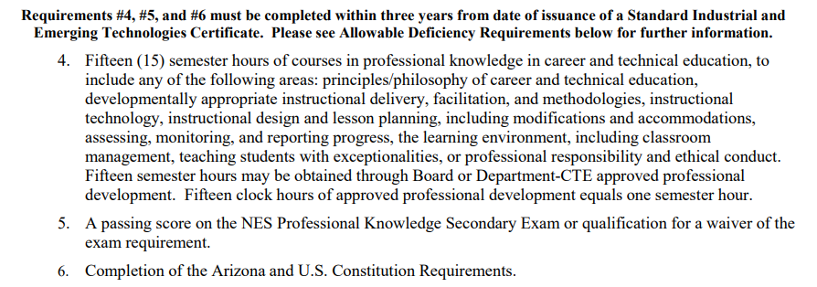
Option A: Requirements

Slide 29
Option B: Requirements

Slide 30
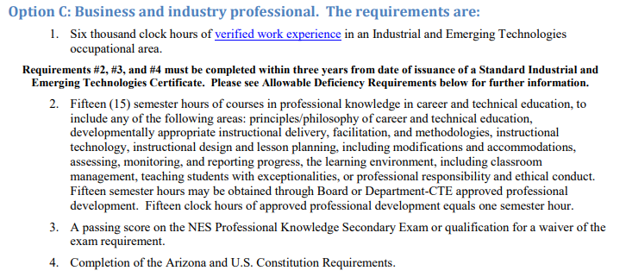
Option C: Requirements

Slide 31
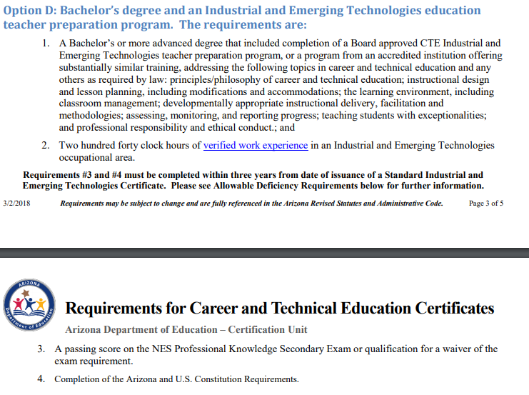
Option D: Requirements

Slide 32
Option E: Requirements

Slide 33
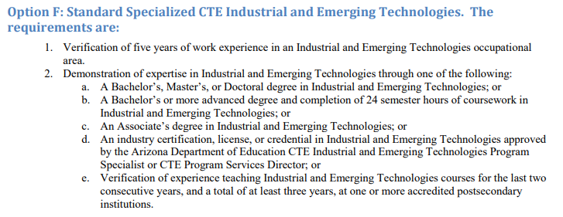
Option F: Requirements
NOTE: Many CTEDs and Districts require or request that Option F teachers take the Premier Series Courses in order to become highly effective in their new profession – Teacher! It simply isn’t a requirement of the Arizona Department of Education for CTE Certificates under option F.

Slide 34
Finally we move to step #4
Step 1
Select the CTE program you want to teach and certificate needed for that program
Step 2
Identify which certification pathway is easiest to meet
Step 3
Identify the requirements and your timeline
Step 4
Identify the supports that are in place to help you earn that certificate

Slide 35
I got my certificate! Now what?
Take your certificate to the County Superintendent’s Office to have it recorded. Check with your HR first as some districts will do this for you
Take your recorded CTE Certificate to the HR Department. They will definitely want a copy of your certificate on file and they may need to provide copies to others in the organization (CTE director etc.)
Keep your CTE Certificate in a secure location

Slide 36
Renewal of your certificate
Your Standard CTE Certificate may be issued with deficiencies. You have 3 years from the date it was issued to clear up your deficiencies or your certificate becomes inactive
Your Standard CTE Certificate will likely be issued for 12 years. During those 12 years keep the PD Certificates you earn in a secure location as you will need to provide evidence of 180 hours of ongoing professional development (an average of 15 hours per year) to renew your certificate for another 12 years.

Slide 37
Do you need TO REGISTER FOR Premier Series courses?
Contact:
Pima JTED: email Mary at mandrade@Pimajted.org or call at 520-256-4169
West-MEC: email pd@west-mec.org or call 623-738-0023
ACTEAZ: email premierseries@acteaz.org or call 623-826-6399
To see a listing of all Premier Series Courses being offered statewide visit:
https://www.azcteleads.org/teacher-series/

Slide 38
Need Certification assistance? Joe Grieco – Arizona Department of Education Certification office – expert in CTE certification 602-542-7412 Joe.Grieco@azed.gov

Slide 39
Thank You
Curt Bertelsen 520-275-5100 cbertelsen@Pimajted.org
Lee Jessen 520-400-3354 ljessen@Pimajted.org
Mary Andrade mandrade@Pimajted.org

