Slide 1
CTE 101 For New Directors

Slide 2
Vocabulary*
Carnegie Unit
Improvement Plan
Performance Measures
*Find vocabulary in Secondary Guidelines Booklet- passed out at CTE Director meeting and on CTE website.

Slide 3
Funding Sources
Perkins
Priority
District
JTED

Slide 4
Who Does What at CTE
Refer to CTE Staff Directory
PS- program specialist
GPS- grant program specialist
Fiscal Specialist
CTSO advisor
Accountability staff
Standards staff
Assessments staff
GME*
*GME

Slide 5
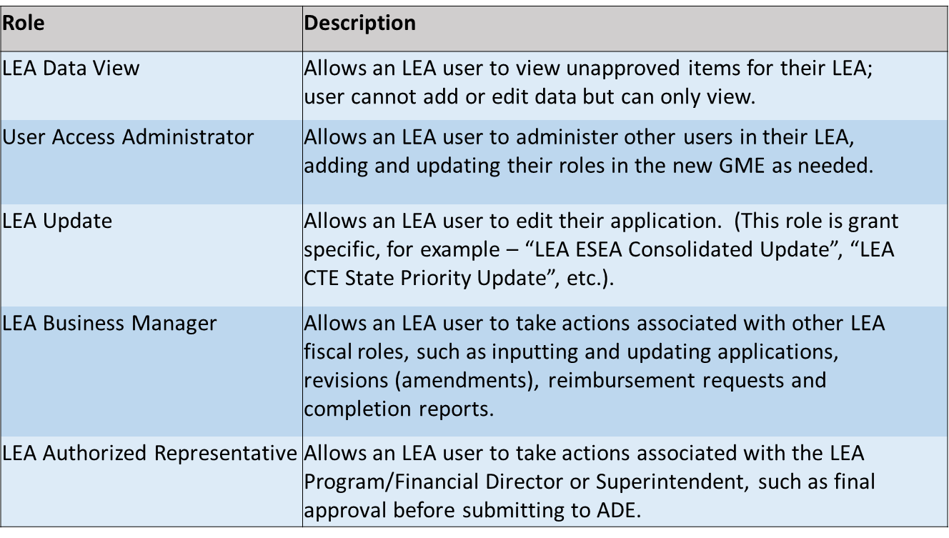
LEA Roles

Slide 6
Grant/ADE Navigation
Directions
Log onto ADE Website
Find CTE
Find Program List
Find Program Areas
Find Equipment List
Find Entity Administrator

Slide 7
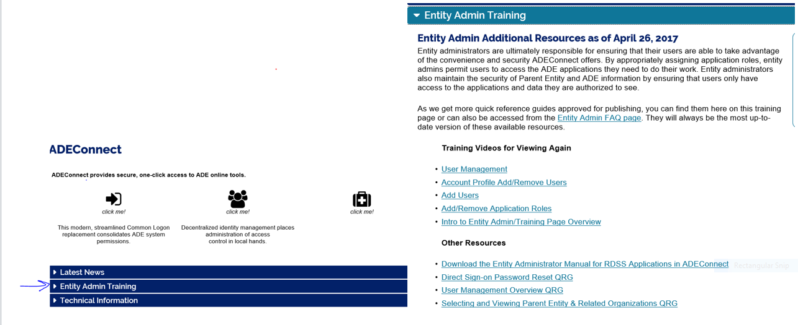
Entity Administrators

Slide 8
Getting Access to CTE Applications*
GME- LEA roles
LEA View
LEA Update
LEA Business Manager
LEA Authorized Representative
CTE Data Portal
Use modify level
Assessments- 3 levels
Level III- Read only
Level II- Teachers
Level I- Coordinator
*For Approval/permission- go to Entity Administrator in ADA Connect

Slide 9
CTE Federal Perkins Funding
What do we get and how can we use it?

Slide 10
How are Perkins Funds Allocated?
District allocations based on census data:
5-17 year olds residing in district (30%)
5-17 year olds below poverty level residing in district (70%)
Perkins funds are NOT affected by school enrollment, CTE enrollment, or number of CTE programs
NOTE
-Perkins funding is supplemental
-LEA (district) must provide the main source of funding CTE programs

Slide 11
Perkins Spending Requirements
All expenditures must support 1 or more of the objectives AND be CTE program specific
Expenditures must be supplementing NOT supplanting
All expenditures must be approved by GPS prior to expending
Project runs from July 1 to September 30th (15 months)
Perkins funds cannot be carried over to next year.

Slide 12
Not Allowed for Perkins
Alcohol
Any entertainment costs (can pay for registration and travel ONLY)
Food (outside of per diem or instructional use)
Awards/Memorabilia
Individual Memberships to Organizations
7th and 8th grade staff salaries or equipment
General classroom supplies and furniture
Required textbooks
Promotional items or promotional advertising

Slide 13
CTE State Priority Funding
What do we get and how can we use it?

Slide 14
State Priority Funding
State Priority funding comes through the Priority Programs State Vocational Block Grant
Now called CTE State Priority Grant
Vocational Education-State Block Grant
Maintenance of Effort (MOE) funds to qualify for Federal Perkins funding

Slide 15
How is Priority Funding Determined?
Funding is based on two items:
1. Number of 11th and 12th grade students enrolled in CTE approved classes (40th and 100th day enrollment)
75% of funding comes from this calculation
2. Related placements-if student placed in work, military or school which was related to CTE program.
25% of funding comes from related placements

Slide 16
What are components of an approved program? Approved program has- certified instructor, placement, concentrator
1. Funding* cannot be provided without one concentrator in that course’s program, unless that
-course’s program is new and still in its 3-year grace period. A new program has 3 years from the date of birth(new) to produce concentrators.
2. Funding* cannot be provided without one placement in that course’s program, unless that
-course’s program is new and still in its 4-year grace period. A new program has 4 years from the date of birth(new) to produce placement.
* Funding for Priority
**Exemption- one very 5 years
Look at nonfunded report- school level in CTE Data Portal

Slide 17
Exemptions

Slide 18
Where Enter 40 +100th Day Enrollment
Baselines- Weeks-18 and Minutes- 225

Slide 19
State Priority Grants
Project dates –
July 1 through June 30th – 12 months
Much simpler application than Perkins
Only requires a budget to be spent on approved CTE programs
Supplemental source of funds for district CTE programs
Materials purchased with state funds must be IN HAND by June 30

Slide 20
Budget
Spend or Lose It *-
For Both Perkins + Priority Grants-
*No carryover

Slide 21
Application Process
Draft Started →
Draft Completed →
LEA Business Manager Approved →
LEA Authorized Representative Approved →
SEA <Program Name> Specialist Approved →
SEA <Program Name> Director Approved →
Notifications after each status to users with that role
May be returned to previous status by each user role if necessary
Only Authorized Representative and Business Managers can START an application (not those with “Update” roles)

Slide 22
2019- Priority

Slide 23
2019-Perkins

Slide 25
Performance Measures

Slide 27
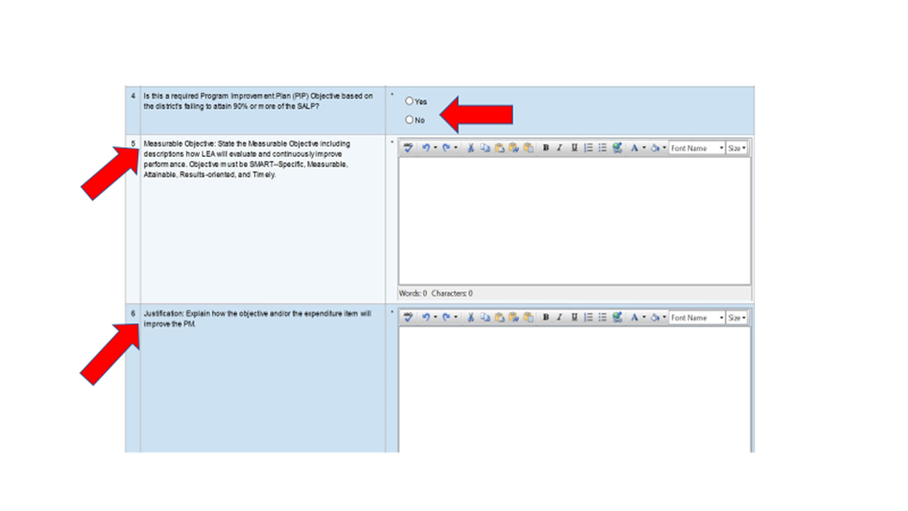
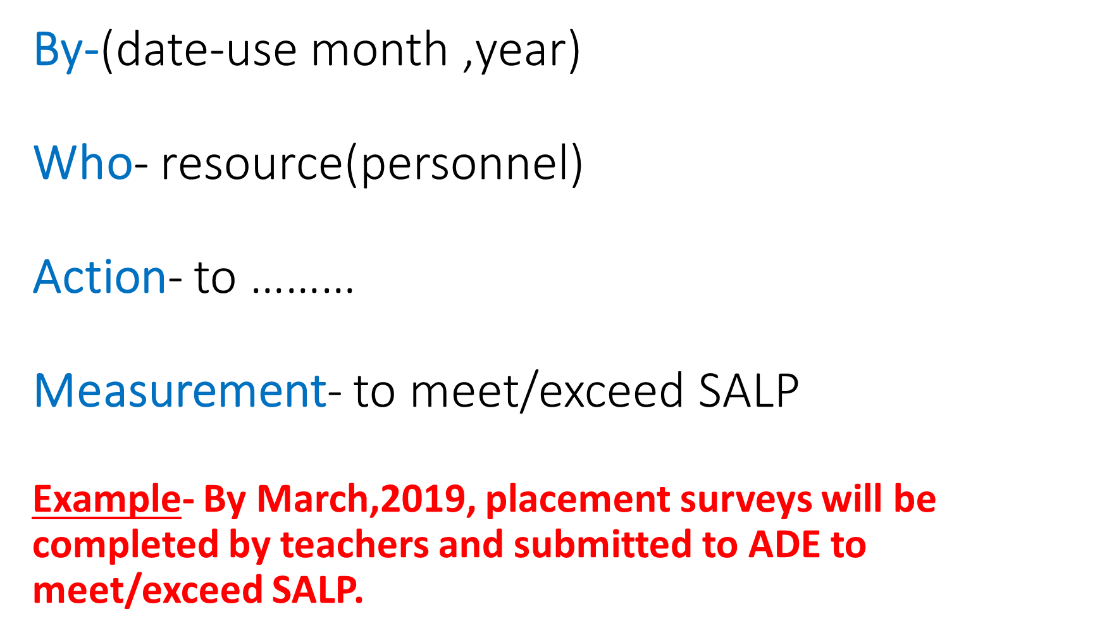

Slide 28
Expenditure- description

Slide 30
HINT
To change from object code to function code- click on

Slide 31
Performance Measures
Alignment with Budget
Best Practice- Link budget to performance measure(example-5S1). Refer to example below.

Slide 32
Object Coding
OBJECT CODE | OBJECT CODE- NAME | EXAMPLES
6100 | Salaries | Stipend
6300 | Purchased Professional Services | Professional Development(PD)
6500 | Other Purchased Services | Travel
6600 | Supplies | Instructional Supplies
6800 | Other Expenses | CTSO Student Registration(Priority)

Slide 33
6100-Salary
If position is new- add “new position” to budget
narrative.

Slide 34
6100- Stipend

Slide 36
Answer this question
What is the difference between travel and transportation?

Slide 38
teacher traveling with students -code 6500-2100 teacher traveling (no students) -code 6500-2100
Perkins-6500-Teacher Travel

Slide 39
Supplies- 6600
Includes program specific instructional supplies(6600-1000)- not general supplies
Useful life of less than 1 year
Replace, don’t repair
STUFF

Slide 40
Supplies
Example 1- Manual blood pressure cuff
-Does it have useful life of more than 1 year?
-Would it be repaired?
Example 2 - Cloth napkins
Example 3 - Scissors for fashion design
STUFF

Slide 41
Supplies- for both Perkins + Priority
All program specific instructional supplies must include the program name, budget, sample of supplies, site (if multi-site)
Example- Fashion Design- $500- tracing paper, pins, thread, cutting boards

Slide 42
Checklist

Slide 43
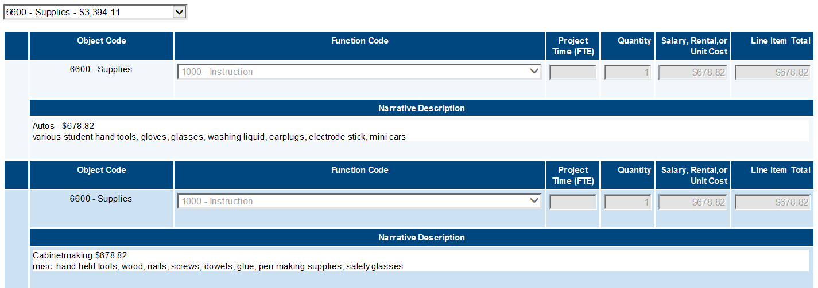
Keep It Simple
For 6600-1000-don’t cluster together but use a separate entry for each program

Slide 44
Supplies-Software
Instructional software- use code 6600-1000
In budget narrative- include CTE program name + name of software program and cost
Do not use codes 6737,6738,6739.Use this code for NON-instructional software

Slide 45
Supplies- Magazine Subscriptions
6600-1000
Narrative-
- Program name
- Name of publication/magazine

Slide 46
Informational Materials
In both budget narrative and performance measures use term “informational materials”
-Do not write- marketing or promotional materials as Perkins does not allow

Slide 47
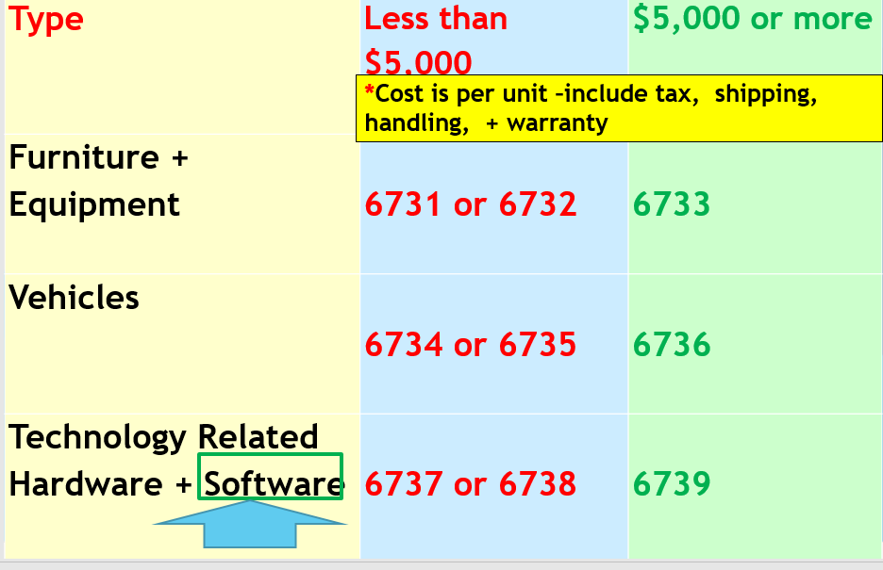

Slide 48
In Application Narrative
*Consumables
On Supplies Spreadsheet
Equipment under $5,000 but not a consumable.
On Capital Worksheet
Equipment $5,000 or more

Slide 49
Capital Outlay
All capital should be specialized equipment for
CTE program
Use CTE program equipment list
-If not on “equipment” list then GPS gets
approval from Program Specialist
Best Practice- be pre-approved by
Program Specialist (PS) before put on worksheet
if not on approved equipment list
Use per unit cost- include tax, shipping, handling, + warranty
I don’t think that is a piece of exercise equipment.

Slide 50
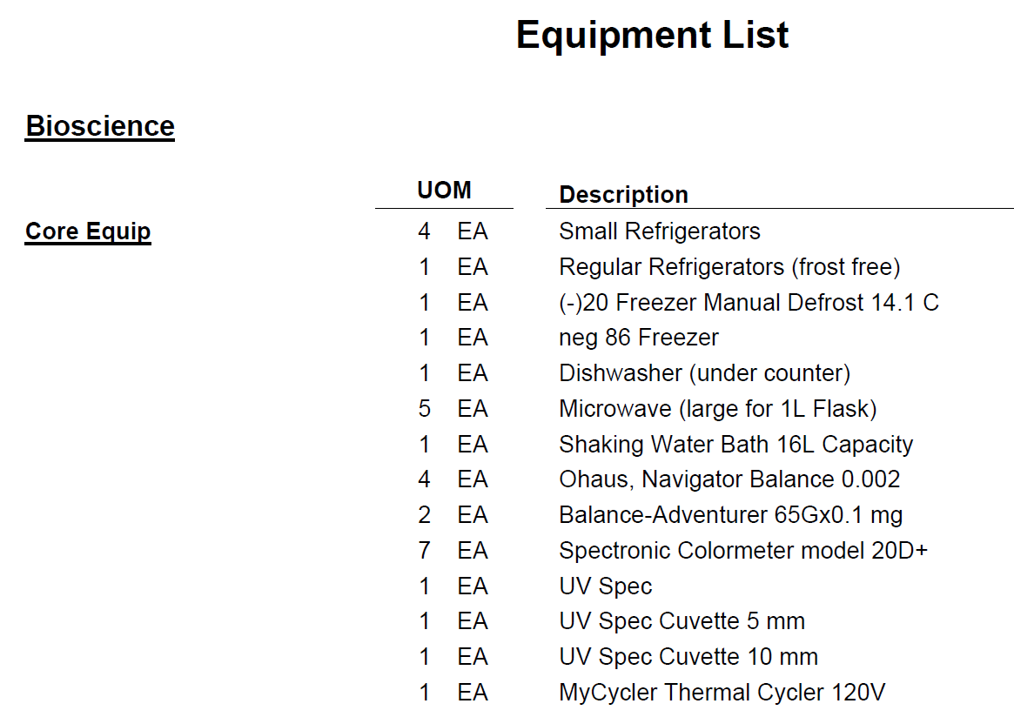

Slide 52
Activity

Slide 53
Label with code-example “6733”

Slide 55
How to Upload in Related Documents
Log-in to ADE Connect
Select CTE Grant
Start a revision
Go to “Sections”
Select “Related Documents”
Click “upload new”
Upload

Slide 56
Code 6800
Certifications-
Both Perkins + Priority-
-Can use to assist with certification fees for ONLY economically disadvantaged students; must
include this in the narrative

Slide 57
Career Exploration
Perkins
-Equipment-
-Grades 7+8- no
-Grade 9- yes
-Instructional Supplies
- Grades 7,8,9- yes
Priority
-Equipment-
-Grades 7,8,9- yes
-Instructional Supplies
- Grades 7,8,9- yes

Slide 59
Reminder-Indirect Cost
Priority- no indirect cost allowed
Perkins- 5% limit on 2300 + indirect cost

Slide 60
Other Grant Guidelines
Priority Grant
Materials purchased with state funds must be IN HAND by June 30
Perkins Grant
Materials purchased with federal funds must be IN HAND by December 30 with money obligated by September 30

Slide 61
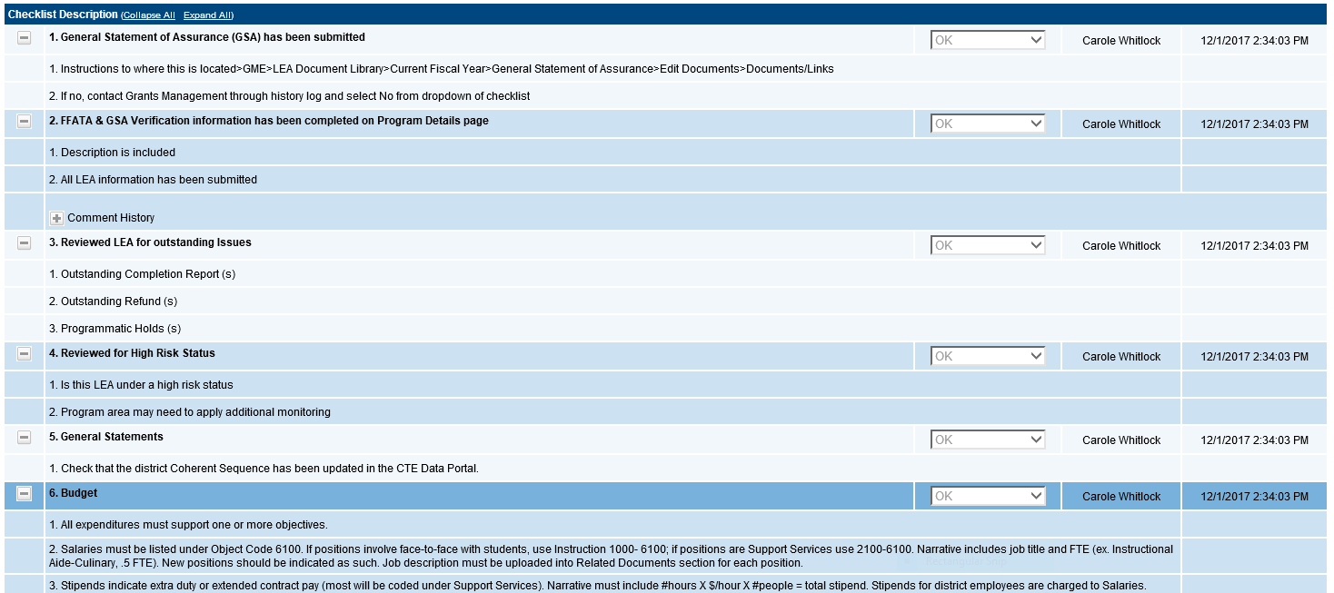
Communication

Slide 62
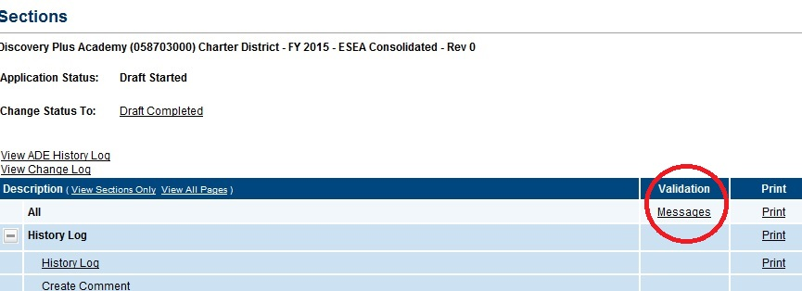
Trouble Shooting
When receiving a message of “Status cannot be changed, validation errors exist.” Check the “Validation” column and
click on the very top “Messages” link
-This will show you errors preventing the submission

Slide 63
Messages page allows you to pinpoint the error or missing information and click directly to the page that needs attention
Each message is a clickable link
Clicking link will take user to the screen on which the issue occurred

Slide 64
CTE makes a difference, too!! Any Questions??

