Slide 1
ASE Update
Tom Richardson
2018

Slide 2
HISTORY OF ORGANIZATIONS
Organization | Founded | ASE Involvement | Audience
ASE | 1972 |  | Technician/Professional Testing & Certification
NATEF | 1983 | 1983 | Students, Program Accreditation
AYES | 1995 | 2009 | Students, School to Work
ATMC | 1984 | 2009 | Trainers, Networking, Best Practices

Slide 3
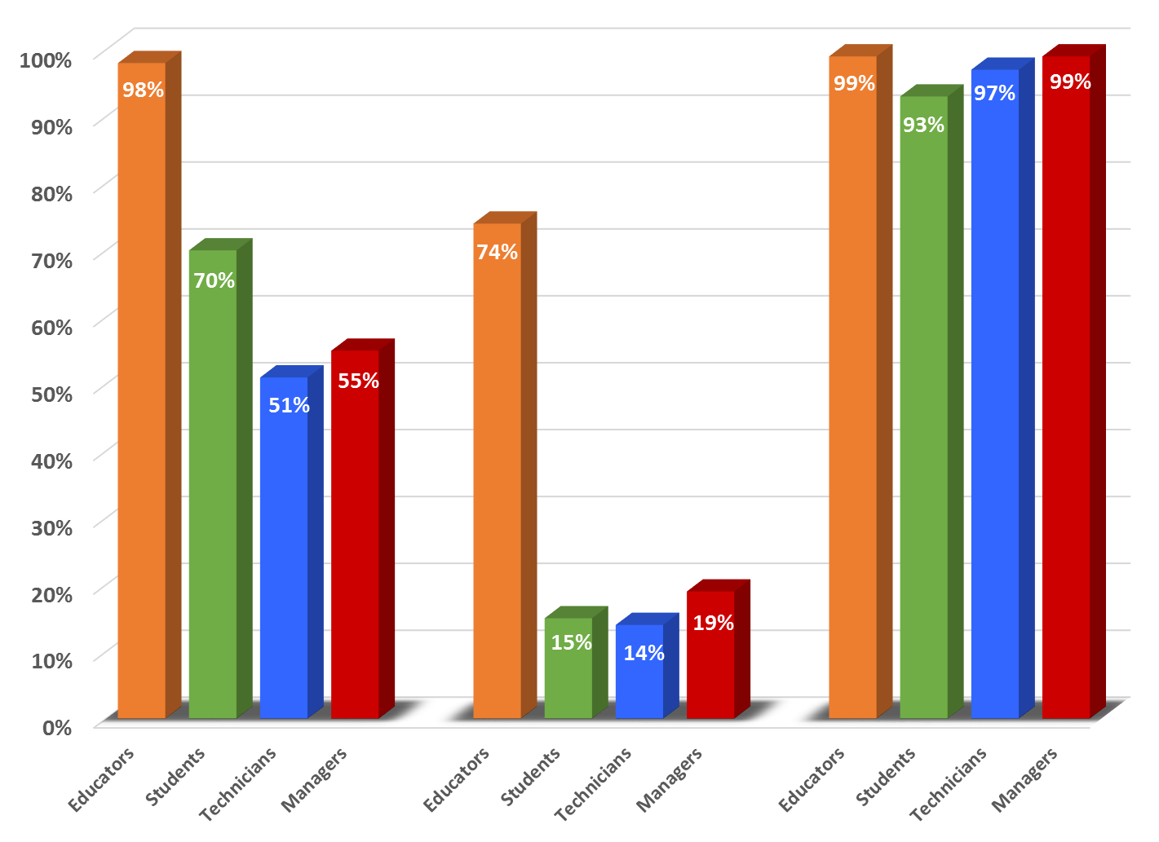
RESEARCH

Slide 4
What is new?

Slide 5
ASE EDUCATION FOUNDATION CORE MISSIONS
Accreditation of Automotive Service Technology Programs
Career Readiness
Job Shadowing
Internships
Partnership Engagement
Instructor Support
Conference
New Instructor Guide

Slide 6
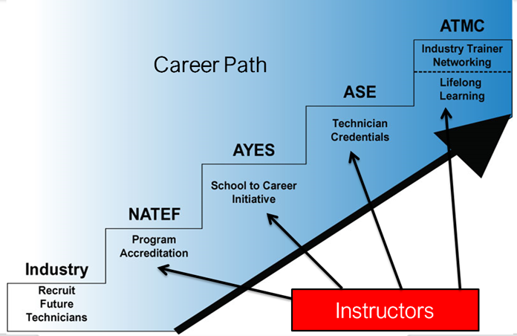
ORGANIZATION CAREER PATH

Slide 7
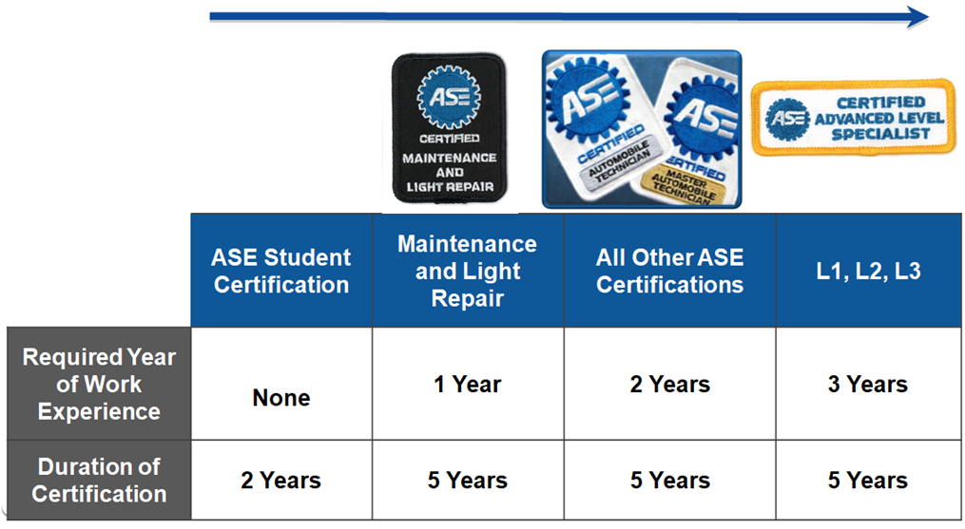

Slide 8
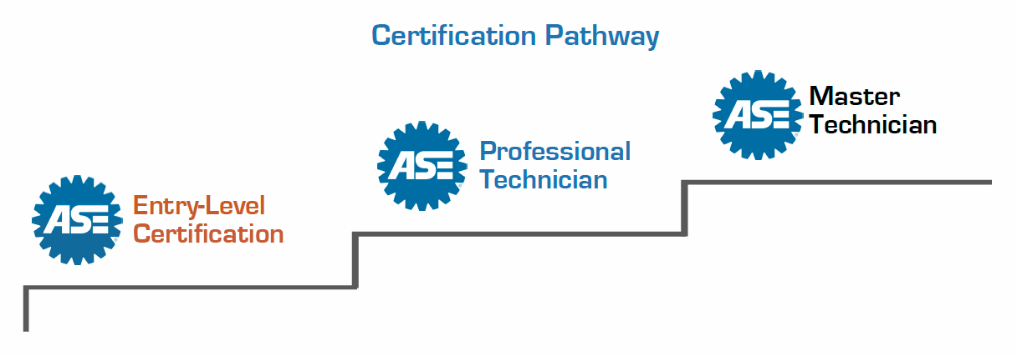
Student certification entry-level
Knowledge based (versus diagnostic)
2 year credential
Auto, truck, collision
Digital badging
Credential authentication
Pricing
Candidate counts

Slide 9
PROFESSIONAL TESTING
Test Development
Test Centers
Network
Security
Results

Slide 10
OTHER TOPICS
609 Testing
Electronic & Paper
Test Failers
CRM Rewrite
World Class Technician Recognition
Government Interaction

