Slide 1
Principles Of Design
Apparel & Interior Design

Slide 2
What is Design?
Design Is . . .
A Plan For Order
The Expression Of The Material
Fulfillment Of Purpose
Follows Natural Laws Of Growth And Order

Slide 3
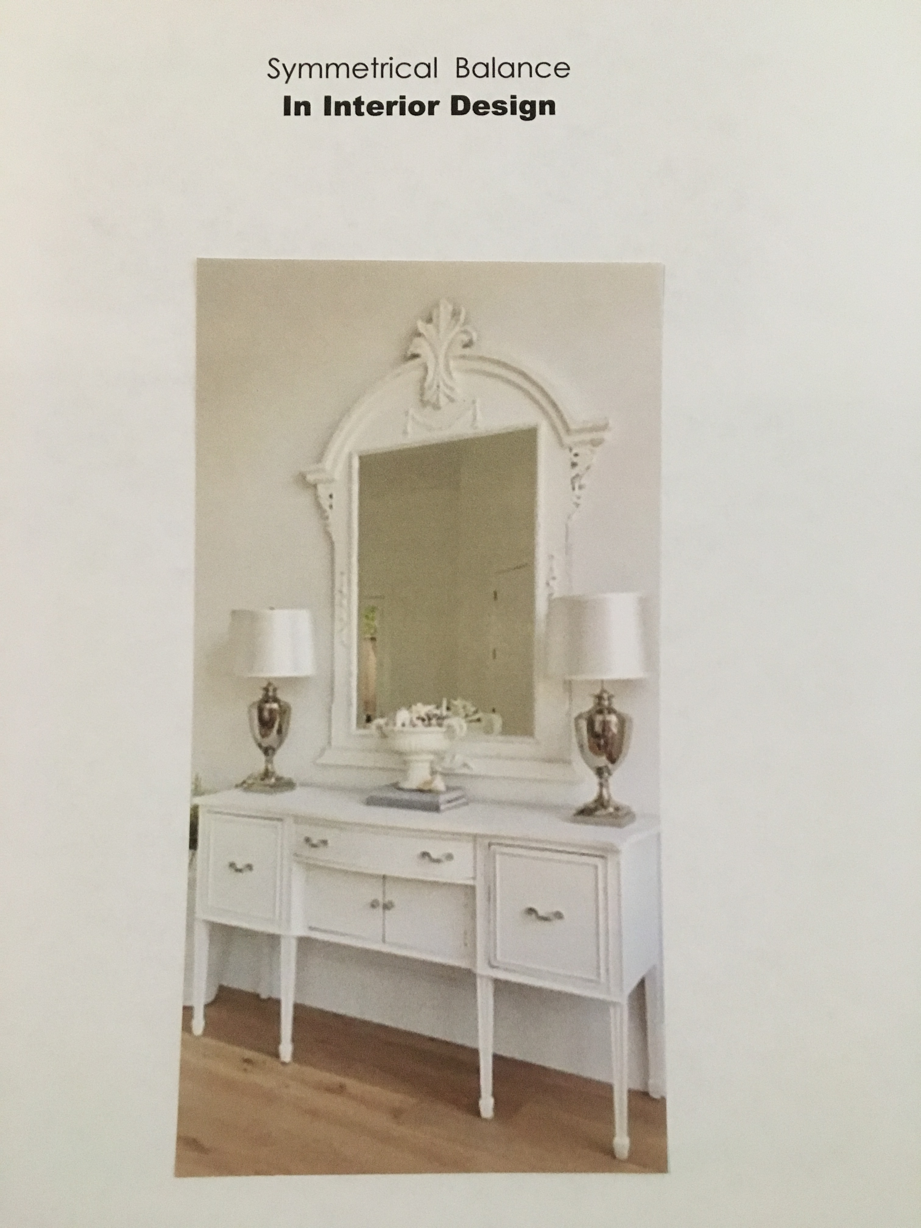
Symmetrical Balance

Slide 4
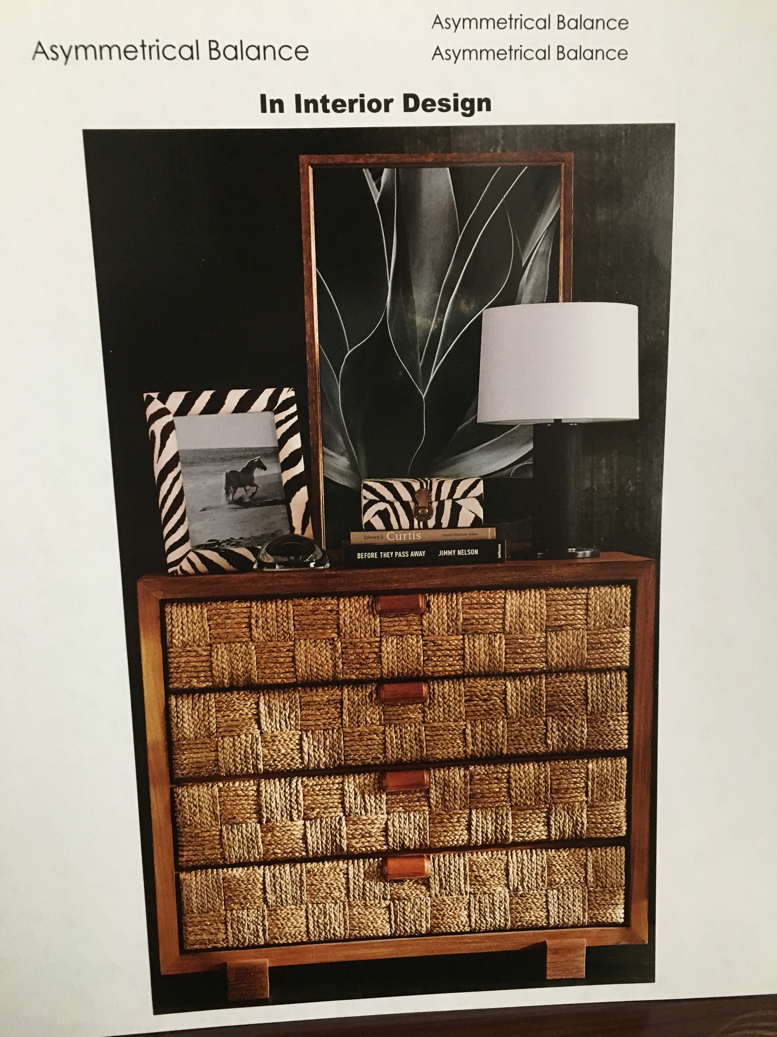
Asymmetrical Balance

Slide 5
Forms Of Rhythm
Repetition
Radiation
Gradation
Opposition
Transition

Slide 6
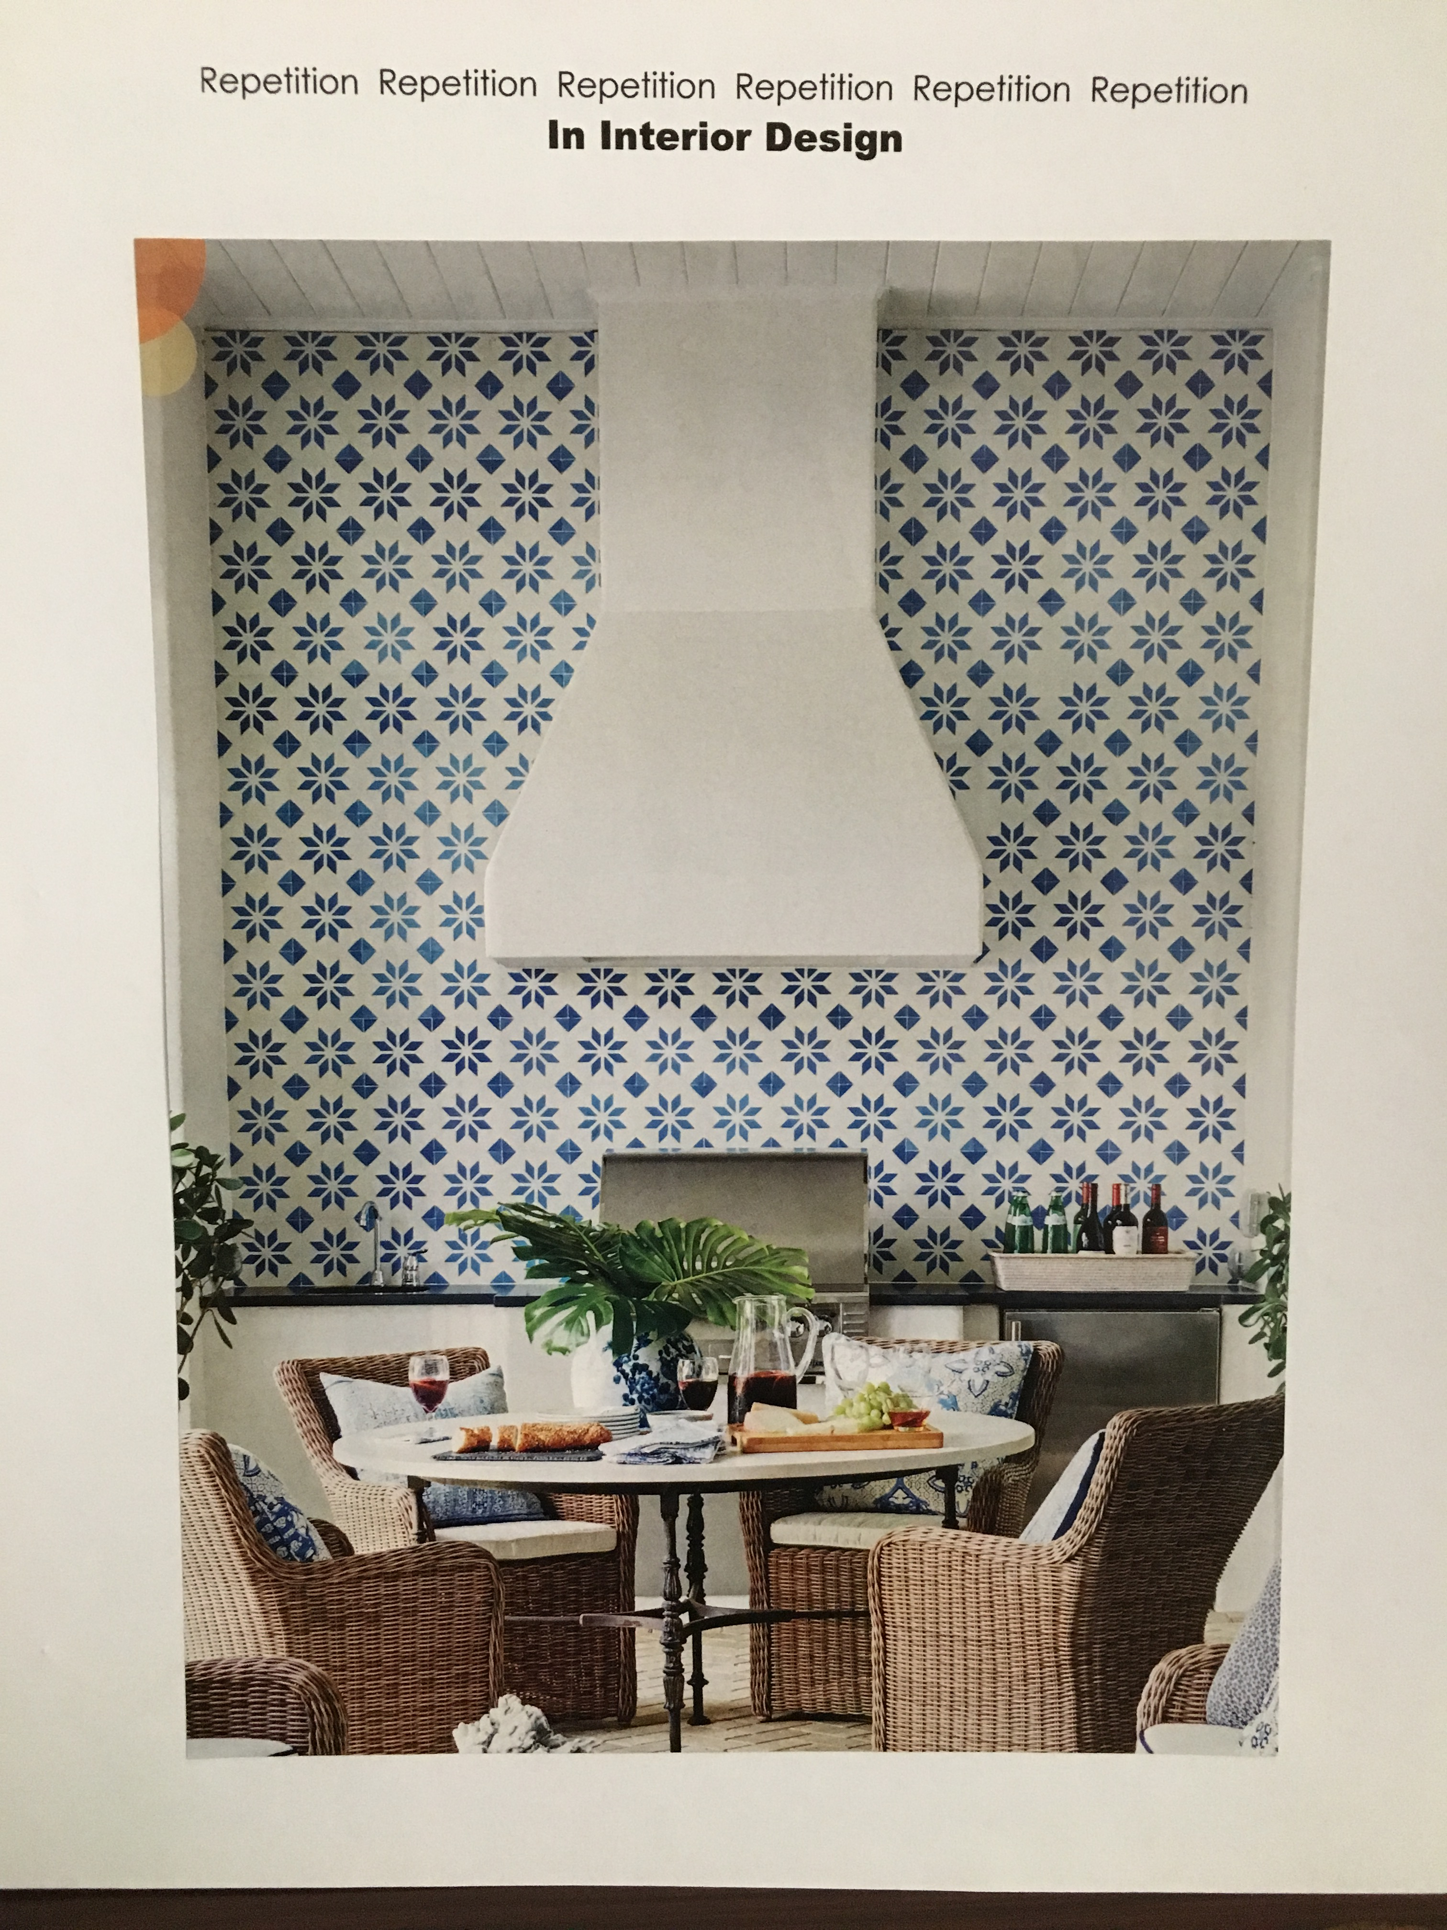
Repetition

Slide 7
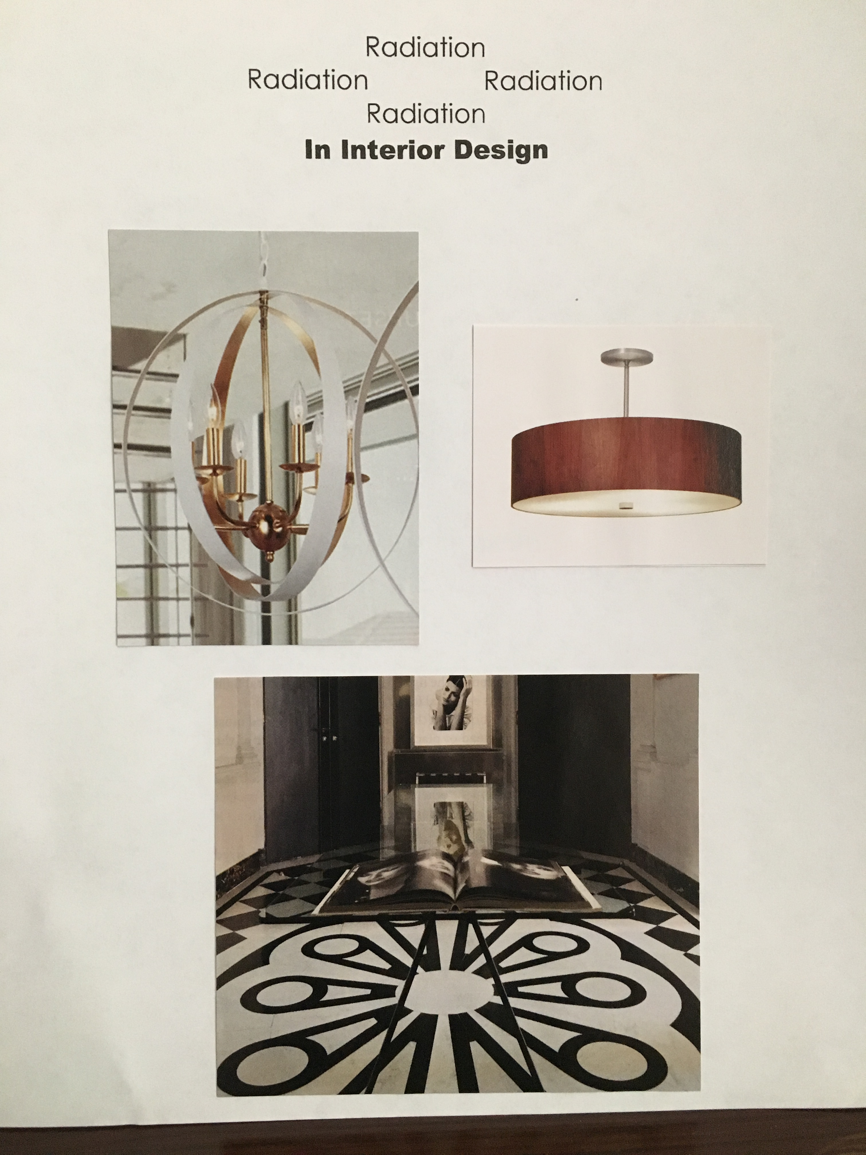
Radiation

Slide 8
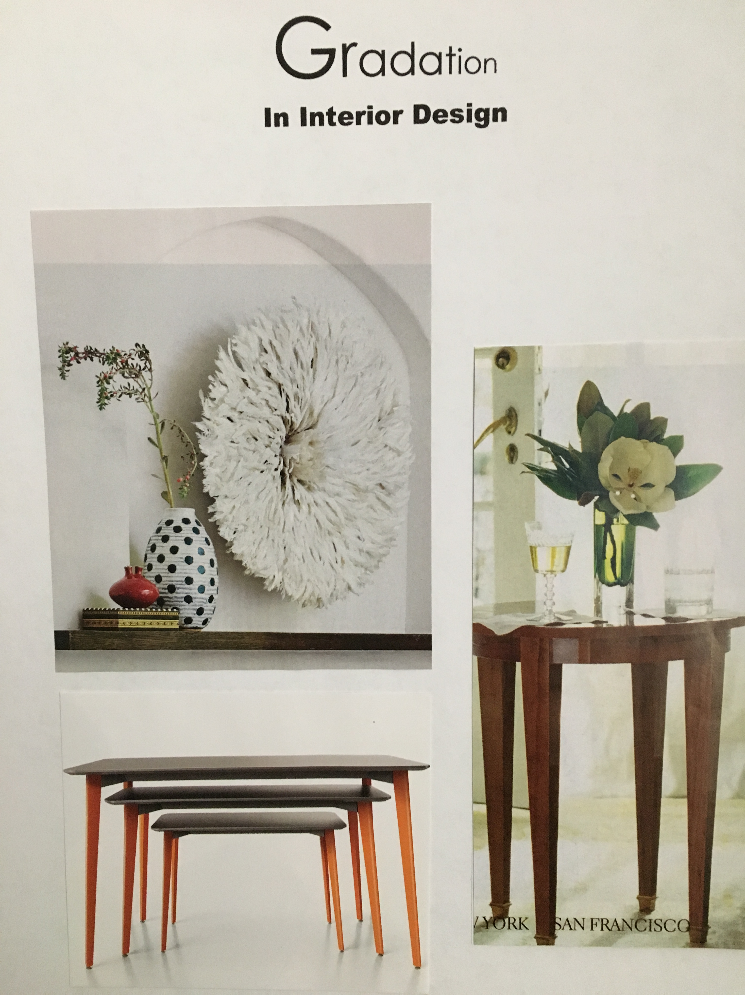
Gradation

Slide 9
Opposition

Slide 10
Transition

Slide 11
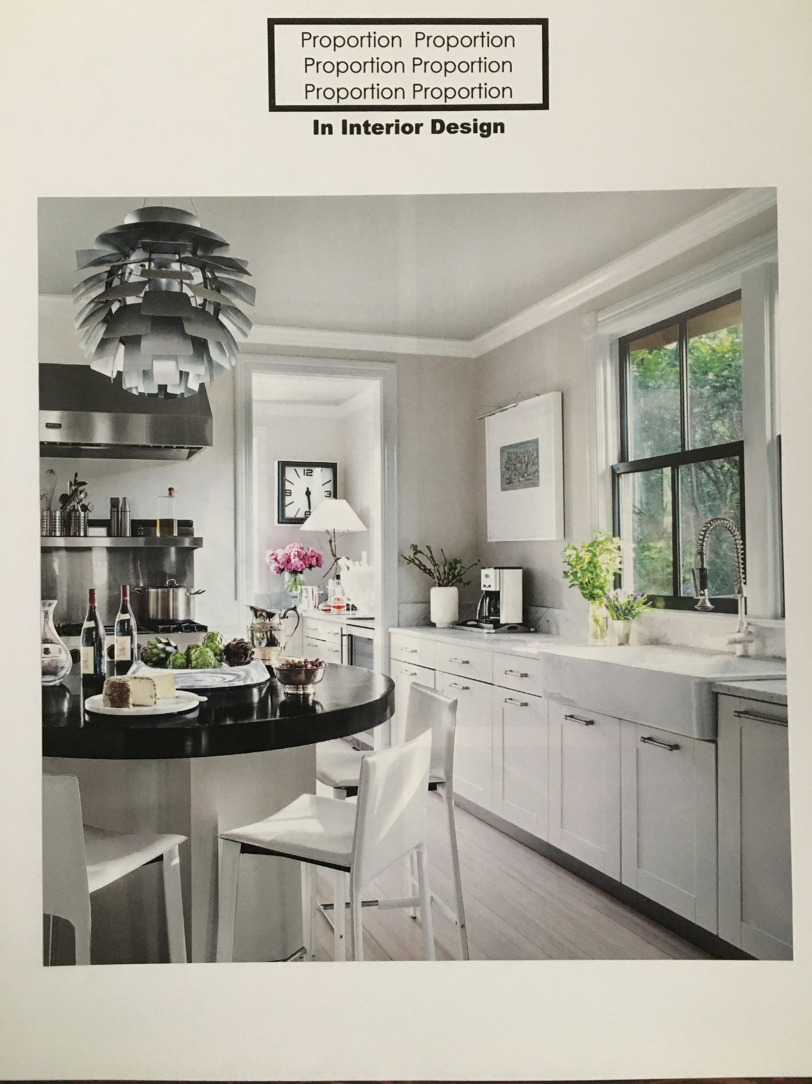
Proportion

Slide 12
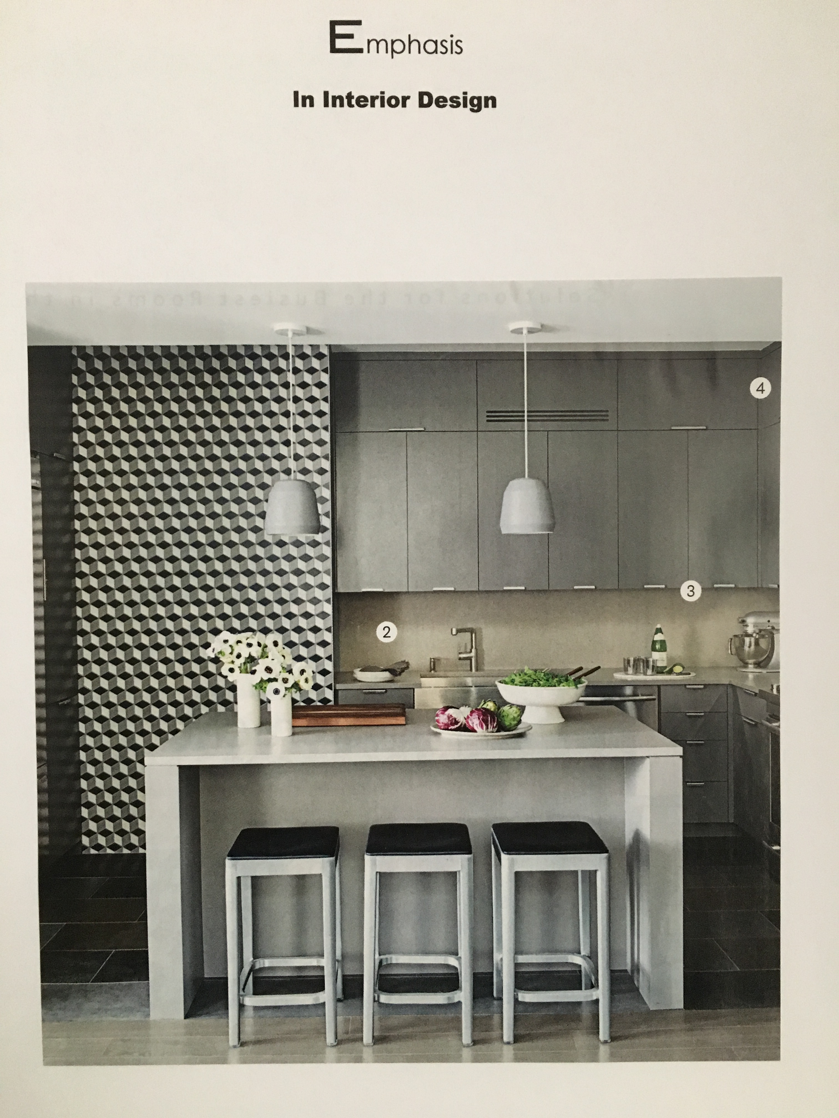
Emphasis

Slide 13
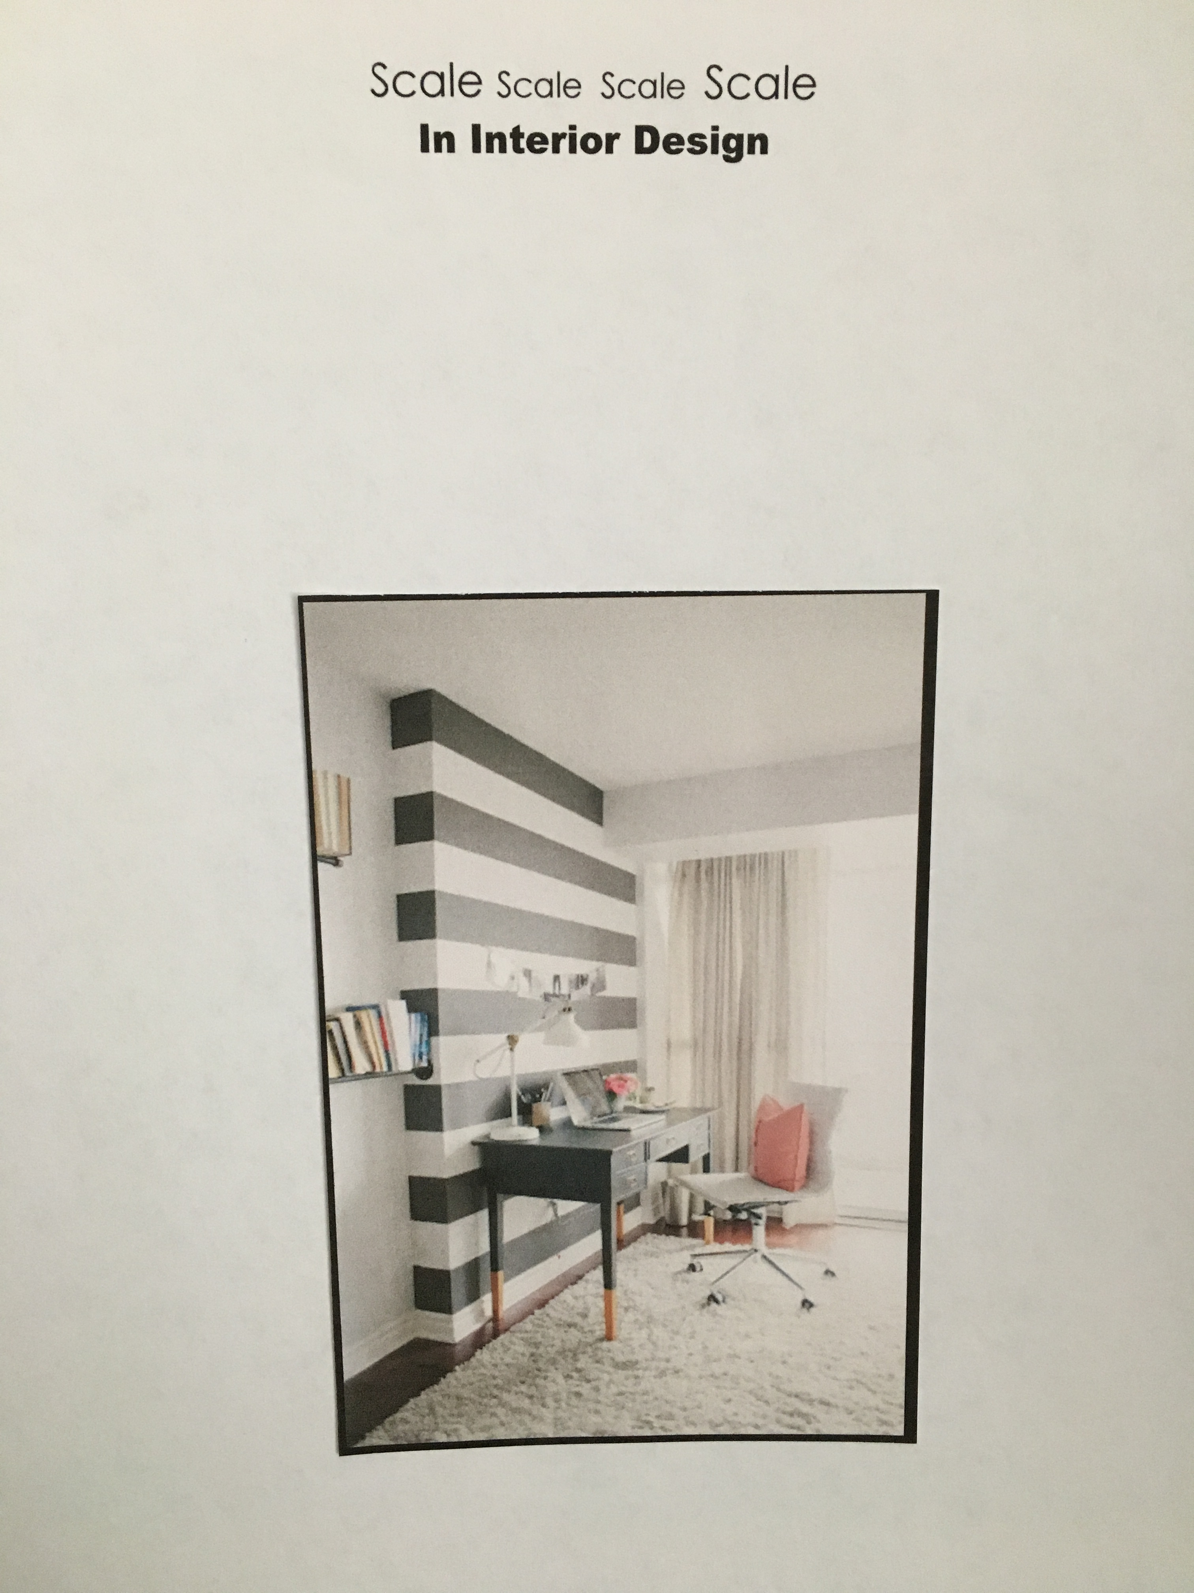
Scale

Slide 14
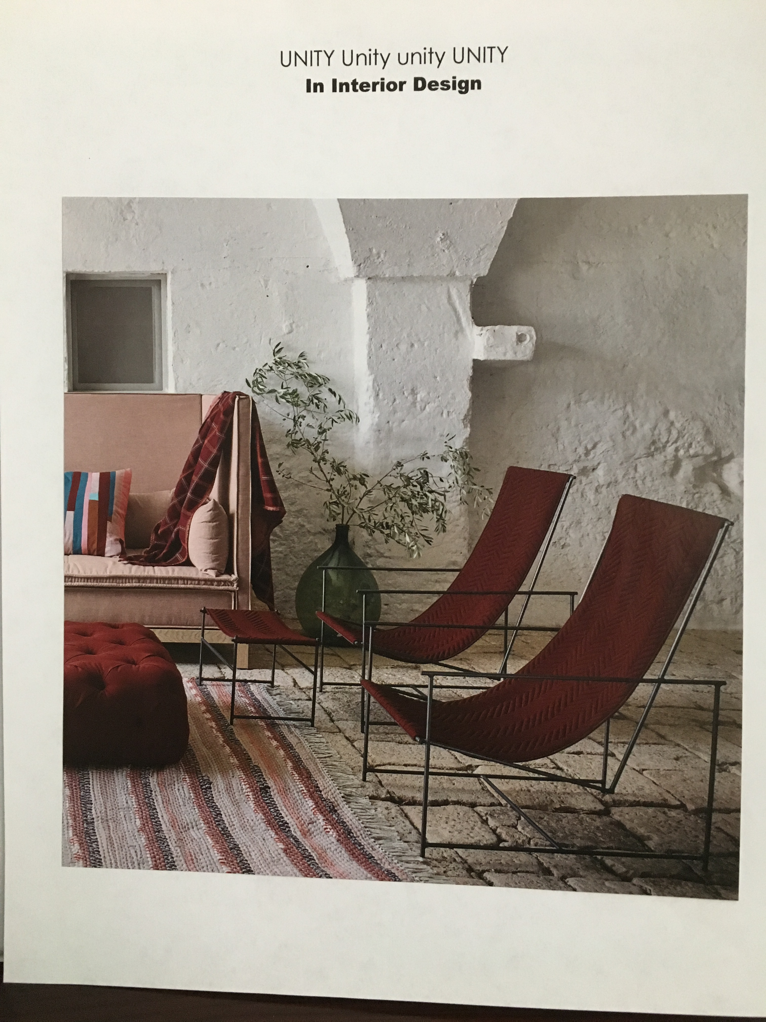
Unity

Slide 15
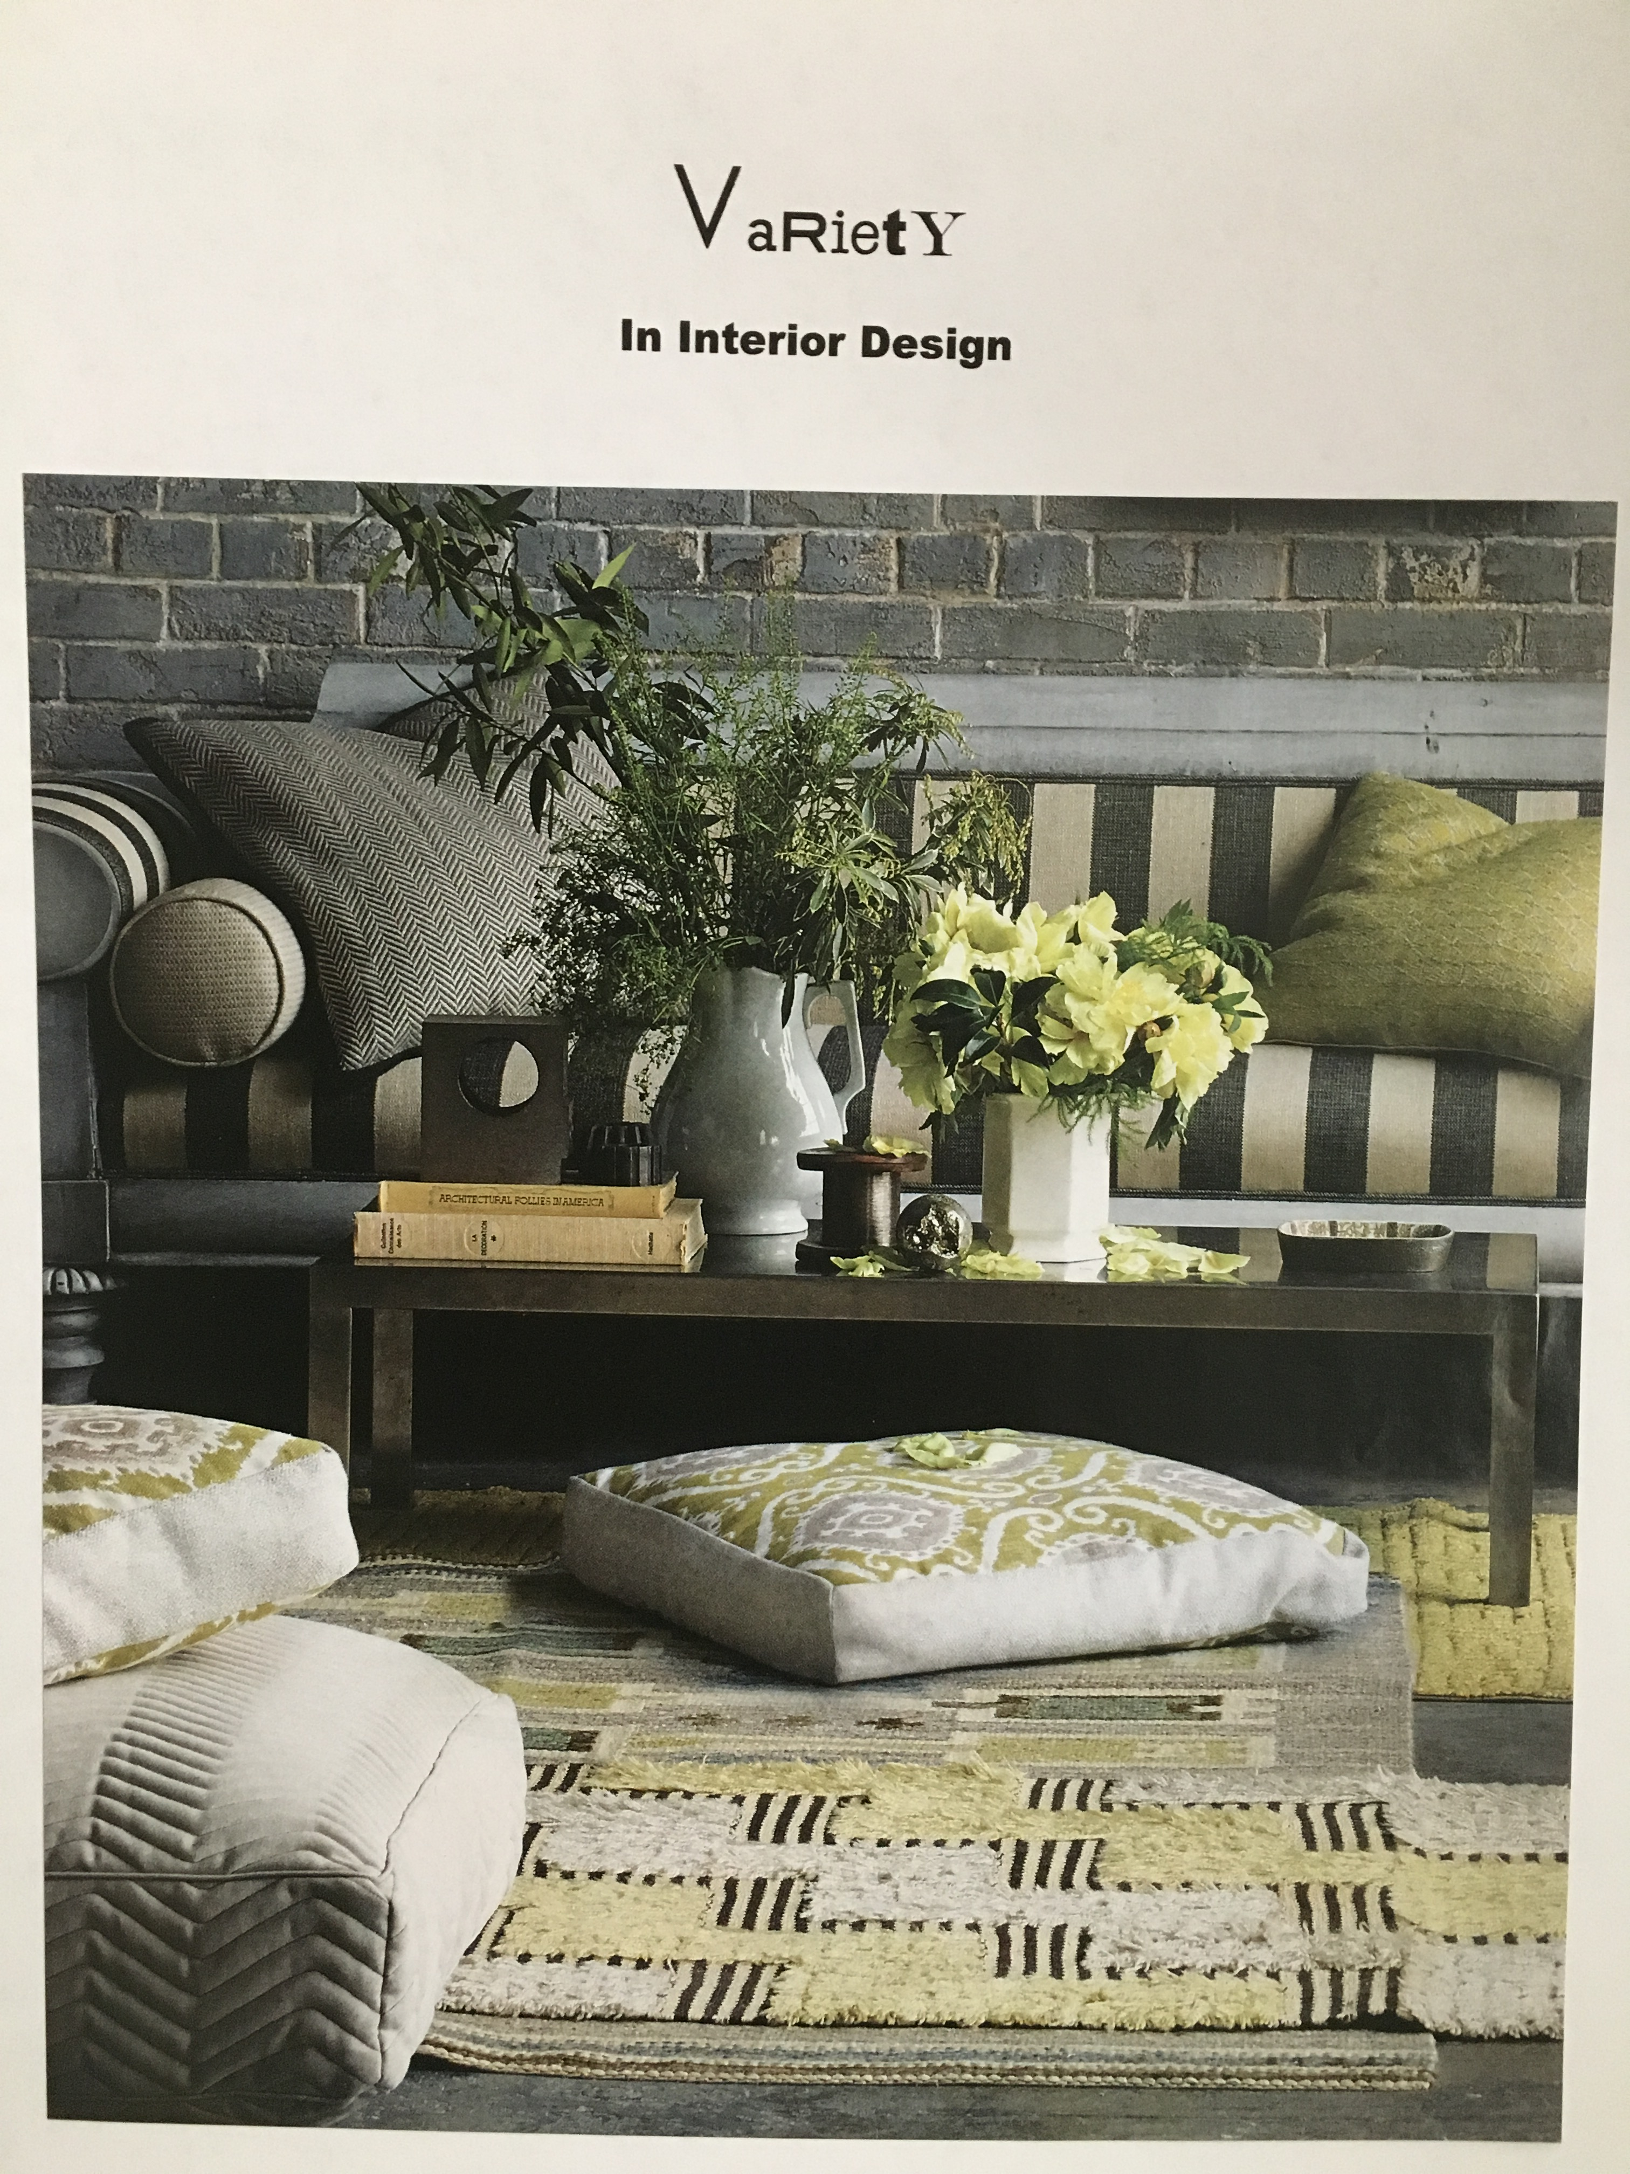
Variety

Slide 16
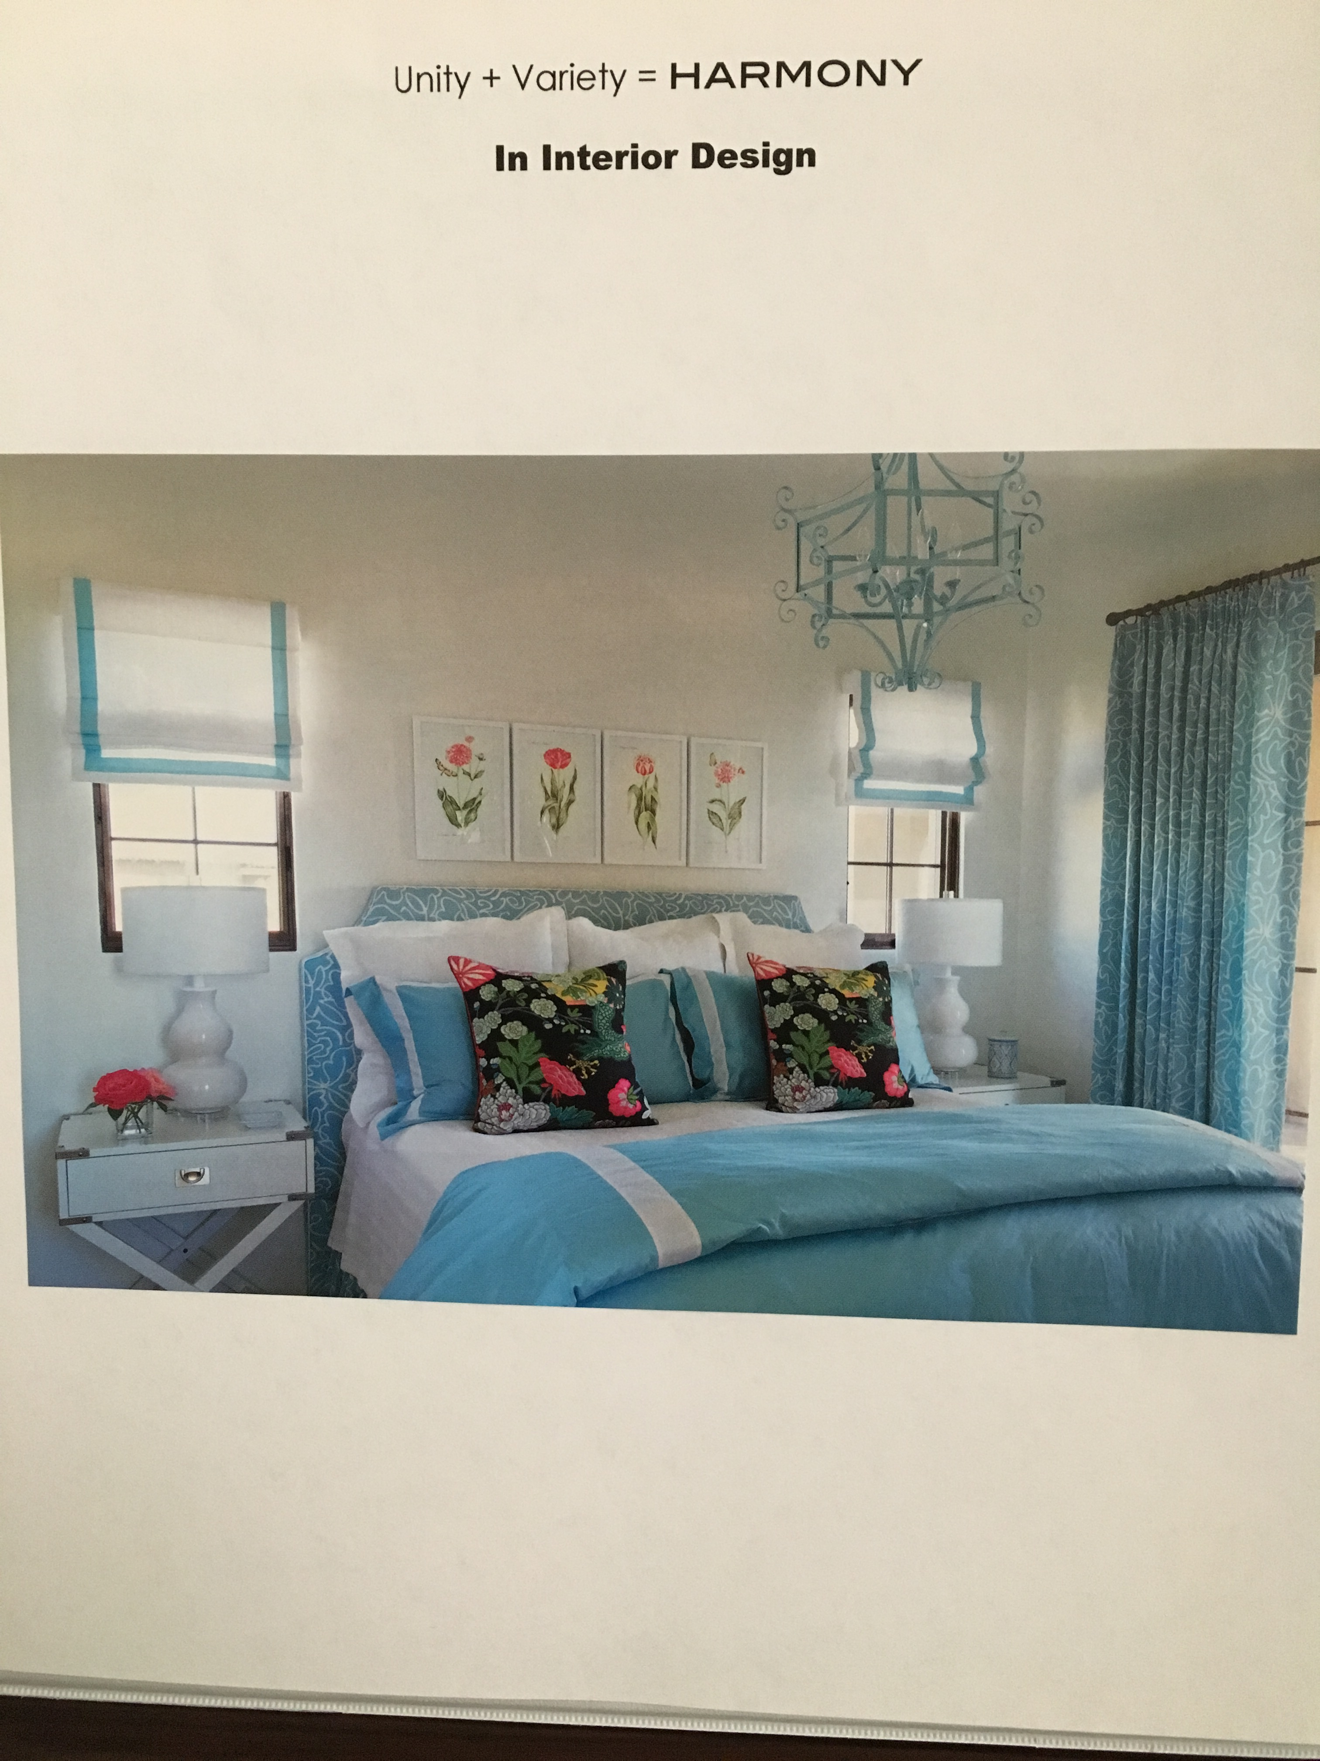
Unity + Variety = HARMONY

