Slide 1
Lean Manufacturing
Mel Wendell – Mountain Pointe High School

Slide 2
Course Agenda
Welcome and Background Information
1st round of Simulation (ENGR Catamaran)
Lean Manufacturing
Lean Principles
2nd round of Simulation (ENGR Catamaran)
Lean Manufacturing Building Blocks
Closure

Slide 3
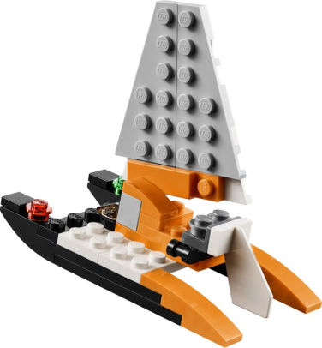
Round 1: ENGR CATAMARAN
Welcome – Team Introductions and Company Names
Departments
  Hull Assembly (2)
  Rudder and Sail Joint Assembly (2)
  Sail Assembly (1)
  Final Assembly (1)
  Quality Control (1)
Goals
    3 Catamarans in 9 minutes
    100 % Quality
Discussion
(#) Recommended students per group.
Notes:
Provide time for introduction of school and what they teach. After Departments, pass out the parts sheet and the work instructions. Make sure they do not read the instructions until they are told to do so!!!

Slide 4
Lean
“A systematic approach to identifying and eliminating waste (non value-added activities) through continuous improvements by flowing the product at the pull of the customer in pursuit of perfect.”
In Other Words:
Give the customer what they want, when they want it and don’t waste anything.

Slide 5
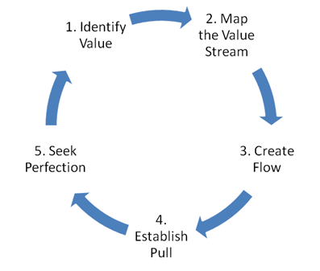
Principles for Lean Manufacturing

Slide 6
Identify Value
Value-Added (5%)
Any activity that changes the form or function of the product.
  Ex – Machining, Fab, Assembly, Molding
Done right the first time. (Quality & Delivery)
Activities the customer is willing to pay for.

Slide 7
Identify Value
Non Value-Added (95%)
Any activity that does not change form or function or is not necessary.
  Ex – Sales, Production Control, Purchasing, HR, Shipping/Receiving, QC, Accounting, etc.
These activities should be eliminated, simplified, reduced, or integrated.

Slide 8
Identify Value
Non Value-Added BUT Necessary
Any activity that does not change form or function BUT is necessary.
  Ex: cleaning/packaging, debur, inspection, etc.
These activities should be simplified, reduced, or integrated.

Slide 9

Map the Value Stream

Slide 10
Waste = Non Value Added
Waste is “anything other than the minimum amount of equipment, materials, parts, space, and worker’s time which are
absolutely essential to add value to the product.”
- Shoichiro Toyoda
President, Toyota

Slide 11

Why Focus on Waste ?
Waste is a symptom signaling Time & Money is trapped in the process
Waste is a systemic flaw affecting people, materials, machines, and/or information
Recognizing waste can lead to identifying the root cause of problems and saving Time & Money

Slide 12
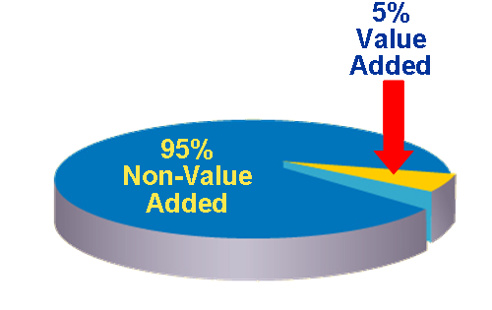
Lean = Eliminating Waste
Defects
Overproduction of work in process
Waiting
Non–value-added processing
Transportation of materials & equipment
Inventory Excesses
Motion
Employees Underutilized
Typically, 95% of all lead time is non–value added!

Slide 13
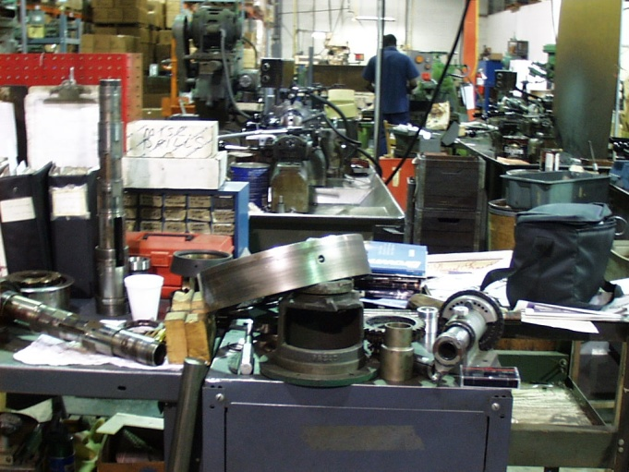
Motion
Any movement of people or machines that does not add value to the product or service
Causes of motion waste:
  Dis-organized work space
  Inconsistent work methods
  Inefficient facility or cell layout
  Insufficient training or supervision
  Inadequate tools or supplies at workstation
Searching
How long would you look?

Slide 14
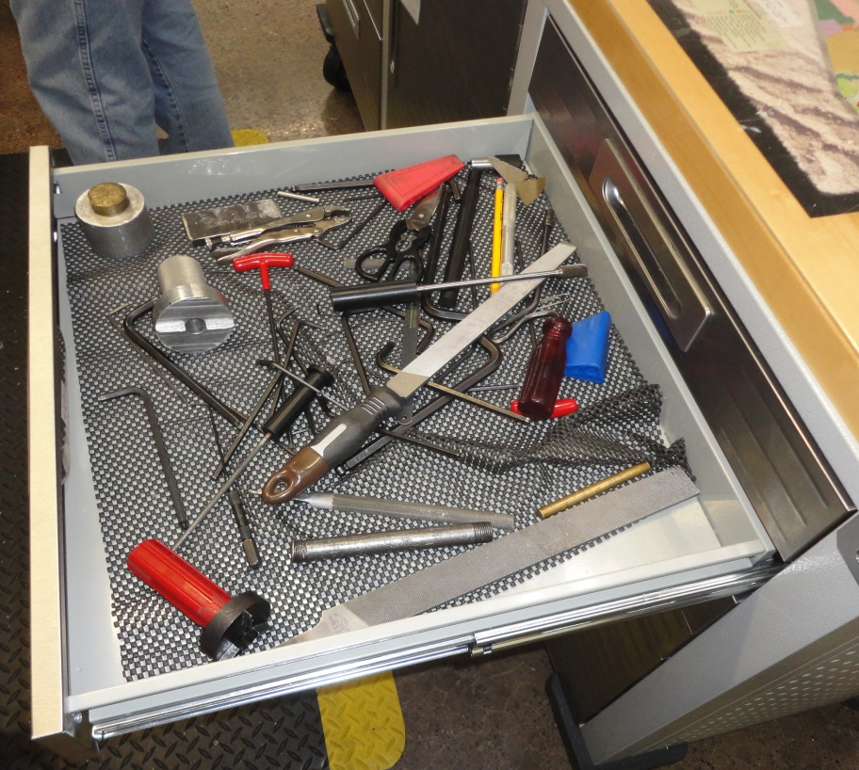
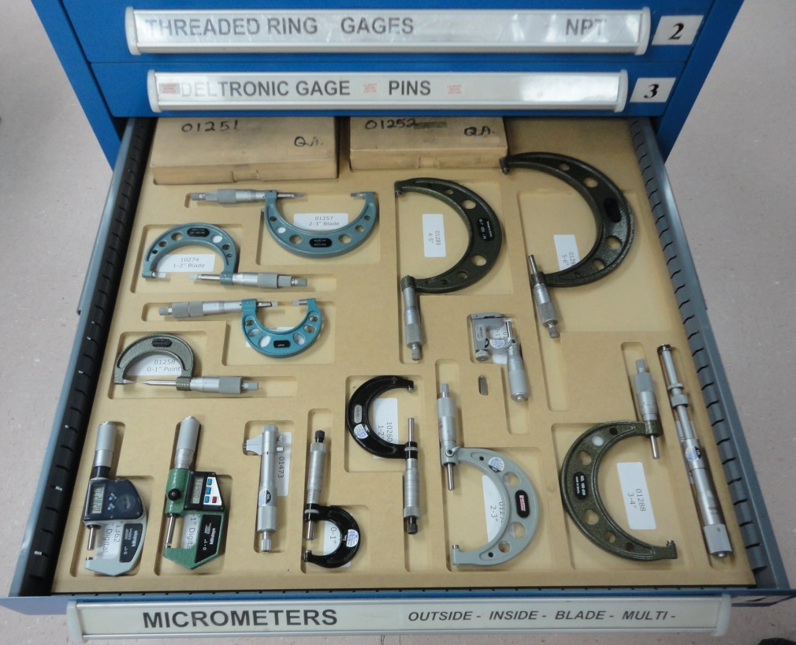
Organization
Limits waste of motion
Better

Slide 15
Creating Flow
Linking of manual and machine operations into the most efficient combination to maximize value-added content while minimizing waste
Hull
Rudder & Sail Joint
Final
Sail

Slide 16
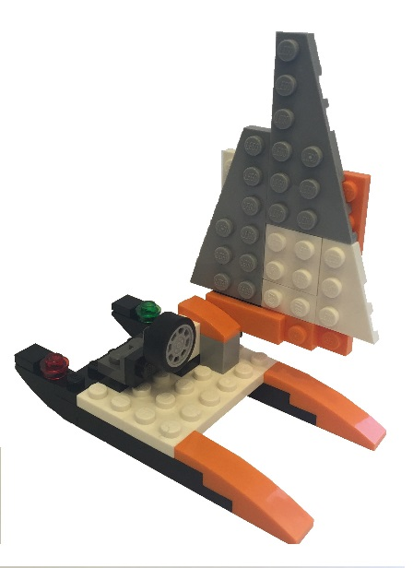
Step 1: Group Products
Processing Steps
 | Hull | Steering | Rudder & Sail Joint | Sail | Test
Catamaran | × |  | × | × | ×
Sail Boat | × | × | × | × | ×
Products with similar processing requirements
are grouped into product families

Slide 17
Step 2: Establish Cycle Time
Demand = Customer order or Production order
Work Time = Quoted or Established production time
Work Time
Demand
Cycle Time =
9 min
3 catamarans
Cycle Time =
= 3 min/catamaran
Goal: Produce to Demand

Slide 18
Step 3: Review Work Sequence
Observe sequence of tasks each worker performs
Break operations into observable elements
Identify value-added versus non-value-added.
Eliminate or minimize
non-value-added
Study machine capacity,
cycle times and changeover
times
Round 1 Sequence Times
Hull 120 sec
Rudder & Sail Joint 75 sec
Sail 30 sec
Final Assembly 20 sec
Inspection 20 sec

Slide 19
Step 4: Combine Work / Balance Process
Unbalanced Line
Balanced Line
Cycle Time = 3 min

Slide 20
Round 2: ENGR CATAMARAN
Departments
  Hull Assembly (3)
  Rudder and Sail Joint Assembly (2)
  Sail Assembly (1)
  Quality Control (1)
Goals
    3 Catamarans in 9 minutes
    100 % Quality
Discussion

Slide 21
Lean Building Blocks
Continuous Improvement
Pull / Kanban
Cellular/Flow
Batch Reduction
Quality at Source
Quick Changeover
POUS
Value
Stream
Mapping
Visual
5S System
Standardized Work

Slide 22
Questions?
Presenter: Melissa Wendell
Session Name: Lean Manufacturing
E-mail: mwendell@tempeunion.org
Notes:
Don’t forget the survey!!!

Slide 23

Thank You.
Notes:
23

